Slide 1
Problem
A farmer with a fox, a goose, and a sack of corn needs to cross a river. Now he is on the east side of the river and wants to go to west side. The farmer has a rowboat, but there is room for only the farmer and one of his three items. Unfortunately, both the fox and the goose are hungry. The fox cannot be left alone with the goose, or the fox will eat the goose. Likewise, the goose cannot be left alone with the sack of corn, or the goose will eat the corn. Given a sequence of moves find if all the three items fox, goose and corn are safe. The input sequence indicate the item carried by the farmer along with him in the boat. ‘F’ – Fox, ‘C’ – Corn, ‘G’ – Goose, N-Nothing. As he is now on the eastern side the first move is to west and direction alternates for each step.

Slide 2
Pseudocode
READ items_carried
SET east as G, C, F
SET west as empty
SET from_Dir = east and to_Dir = west
FOR each item in items_carried
IF from_Dir == east THEN
remove item from east and add to west
IF east or west contains ‘C’ and ‘G’ or ‘G’ and ‘F’ THEN
PRINT ‘NOT SAFE’
BREAK
ELSE
remove item from west and add to east
IF east or west contains ‘C’ and ‘G’ or ‘G’ and ‘F’ THEN
PRINT ‘NOT SAFE’
BREAK
END IF
IF from_Dir == east THEN
SET from_Dir = west
SET to_Dir = east
ELSE
SET from_Dir = east
SET to_Dir = west
END IF
END FOR
PRINT ‘SAFE’

Slide 3
While going for a Shopping ….!!!???
Imagine you have the scores in “Python Programming” for 100 students. If you want to find the average score in Python…?

Slide 4
Simple Statistics
Many programs deal with large collections of similar information.
Words in a document
Students in a course
Data from an experiment
Customers of a business
Graphics objects drawn on the screen
Cards in a deck

Slide 5
List

Slide 6
Examples
Apple, Banana, Berry, Mango
Football, Basketball, Throwball, Tennis, Hockey
Sunrise, Sugar, Cheese, Butter, Pickle, Soap, Washing Powder, Oil….
Agra, Delhi, Kashmir, Jaipur, Kolkata…

Slide 7
Introduction
Contains multiple values that are logically related
List is a type of mutable sequence in Python
Each element of a list is assigned a number – index / position
Can do indexing, slicing, adding, multiplying, and checking for membership
Built-in functions for finding length of a sequence and for finding its largest and smallest elements

Slide 8
What is a List?
Most flexible data type in Python
Comma-separated items can be collected in square brackets
Good thing is..
THE ITEMS IN THE LIST NEED NOT BE OF SAME TYPE

Slide 9
Creating a list
Creating an EMPTY list
listname = []
Example:
L1 = []
MyList = []
Books = []
Creating a list with items
listname = [item1, item2, ….]
Example:
Temp = [100, 99.8, 103, 102]
S = [‘15BIT0001’, ‘Achu’, 99.9]
L2 = [1, 2, 3, 4, 5, 6, 7]
Course = [‘Python’, ‘C’, ‘C++’, ‘Java’]

Slide 10
Accessing Values
Using index or indices
>>>L1 = [1, 2, 3, 4, 5, 6]
>>>print (L1[3]) #indexing
>>>4
>>>print (L1[2:5]) #slicing
>>>[3, 4, 5]

Slide 11
Updating Elements
Update an element in list using index
>>>L1 = [1, 2, 3, 4, 5, 6]
>>>L1[2] = 111
>>>L1
[1, 2, 111, 4, 5, 6]

Slide 12
Deleting Elements
Delete an element in list using index
>>>L1 = [1, 2, 3, 4, 5, 6]
>>>del (L1[4])
>>>L1
[1, 2, 111, 4, 6]

Slide 13
Basic Operations in List
>>> len([1, 2, 3]) # Length
3
>>> [1, 2, 3] + [4, 5, 6] # Concatenation
[1, 2, 3, 4, 5, 6]
>>> ['Ni!'] * 4 # Repetition ['Ni!', 'Ni!', 'Ni!', 'Ni!']

Slide 14
Basic Operations in List
>>> str([1, 2]) + "34" # Same as "[1, 2]" + "34"
'[1, 2]34'
>>> [1, 2] + list("34")
# Same as [1, 2] + ["3", "4"]
[1, 2, '3', '4‘]

Slide 15
List Iteration
>>> 3 in [1, 2, 3] # Membership
True
>>> for x in [1, 2, 3]:
print(x, end=' ')
# Iteration (2.X uses: print x,) ... 1 2 3
Notes:
for x in [1, 2, 3]:
print(x, "\t")

Slide 16
List Comprehensions
>>> res = [c * 4 for c in 'SPAM']
# List comprehensions
>>> res
['SSSS', 'PPPP', 'AAAA', 'MMMM']
expression is functionally equivalent to a for loop that builds up a list of results manually
list comprehensions are simpler to code and likely faster to run today:

Slide 17
List Comprehensions
# List comprehension equivalent ...
>>> res = []
>>> for c in 'SPAM':
res.append(c * 4)
>>> res
['SSSS', 'PPPP', 'AAAA', 'MMMM']

Slide 18
Map
map built-in function applies a function to items in a sequence and collects all the results in a new list
>>> list(map(abs, [−1, −2, 0, 1, 2]))
# Map a function across a sequence
[1, 2, 0, 1, 2]

Slide 19
Indexing, Slicing
>>> L = ['spam', 'Spam', 'SPAM!']
>>> L[2] # Offsets start at zero
'SPAM!'
>>> L[−2] # Negative: count from the right
'Spam'
>>> L[1:] # Slicing fetches sections
['Spam', 'SPAM!']

Slide 20
Matrixes
a basic 3 × 3 two-dimensional list-based array: >>> matrix = [[1, 2, 3], [4, 5, 6], [7, 8, 9]]
With one index, you get an entire row (really, a nested sublist), and with two, you get an item within the row:
>>> matrix[1]
[4, 5, 6]

Slide 21
Matrixes
>>> matrix[1][1]
5
>>> matrix[2][0]
7
>>> matrix = [[1, 2, 3],
[4, 5, 6],
[7, 8, 9]]
>>> matrix[1][1]
5

Slide 22
Insertion, Deletion and Replacement
>>> L = [1, 2, 3]
>>> L[1:2] = [4, 5] # Replacement/insertion
>>> L
[1, 4, 5, 3]
>>> L[1:1] = [6, 7] # Insertion (replace nothing)
>>> L
[1, 6, 7, 4, 5, 3]
>>> L[1:2] = [] # Deletion (insert nothing)
>>> L
[1, 7, 4, 5, 3]

Slide 23
Insertion, Deletion and Replacement
>>> L = [1]
>>> L[:0] = [2, 3, 4]
# Insert all at :0, an empty slice at front
>>> L
[2, 3, 4, 1]
>>> L[len(L):] = [5, 6, 7]
# Insert all at len(L):, an empty slice at end
>>> L
[2, 3, 4, 1, 5, 6, 7]

Slide 24
List method calls
>>> L = ['eat', 'more', 'SPAM!']
>>> L.append('please')
# Append method call: add item at end
>>> L
['eat', 'more', 'SPAM!', 'please']
>>> L.sort() # Sort list items ('S' < 'e')
>>> L
['SPAM!', 'eat', 'more', 'please']

Slide 25
More on Sorting Lists
>>> L = ['abc', 'ABD', 'aBe']
>>> L.sort() # Sort with mixed case
>>> L
['ABD', 'aBe', 'abc']
>>> L = ['abc', 'ABD', 'aBe']
>>> L.sort(key=str.lower) # Normalize to lowercase
>>> L
['abc', 'ABD', 'aBe']

Slide 26
More on Sorting Lists
>>> L.sort(key=str.lower, reverse=True)
# Change sort order
>>> L ['aBe', 'ABD', 'abc']

Slide 27
Other common list methods
>>> L = [1, 2]
>>> L.extend([3, 4, 5])
# Add many items at end (like in-place +)
>>> L [1, 2, 3, 4, 5]
>>> L.pop()
# Delete and return last item
5

Slide 28
Other common list methods
>>> L
[1, 2, 3, 4]
>>> L.reverse() # In-place reversal method
>>> L
[4, 3, 2, 1]
>>> list(reversed(L)) # Reversal built-in with a result (iterator)
[1, 2, 3, 4]

Slide 29
Other common list methods
>>> L = ['spam', 'eggs', 'ham']
>>> L.index('eggs') # Index of an object (search/find)
1
>>> L.insert(1, 'toast') # Insert at position
>>> L
['spam', 'toast', 'eggs', 'ham']
>>> L.remove('eggs') # Delete by value
>>> L
['spam', 'toast', 'ham']

Slide 30
Other common list methods
>>> L.pop(1) # Delete by position 'toast'
>>> L
['spam', 'ham']
>>> L.count('spam') # Number of occurrences 1
1

Slide 31
Other common list methods
>>> L = ['spam', 'eggs', 'ham', 'toast']
>>> del L[0] # Delete one item
>>> L
['eggs', 'ham', 'toast']
>>> del L[1:] # Delete an entire section
>>> L # Same as L[1:] = []
['eggs‘]

Slide 32
Other common list methods
>>> L = ['Already', 'got', 'one']
>>> L[1:] = []
>>> L
['Already']
>>> L[0] = []
>>> L
[[]]

Slide 33
Hence…
A list is a sequence of items stored as a single object.
Items in a list can be accessed by indexing, and sub lists can be accessed by slicing.
Lists are mutable; individual items or entire slices can be replaced through assignment statements.
Lists support a number of convenient and frequently used methods.
Lists will grow and shrink as needed.

Slide 34
Strings and Lists
>>> S = 'spammy'
>>> L = list(S)
>>> L
['s', 'p', 'a', 'm', 'm', 'y']
>>> L[3] = 'x' # Works for lists, not strings
>>> L[4] = 'x‘
>>> L
['s', 'p', 'a', 'x', 'x', 'y']
>>> S = “ “.join(L) #uses ‘’ for joining elements of list
>>> S
'spaxxy‘

Slide 35
Strings and Lists
>>> 'SPAM'.join(['eggs', 'sausage', 'ham', 'toast']) 'eggsSPAMsausageSPAMhamSPAMtoast‘
# uses ‘SPAM’ for joining elements of list
>>> line = 'aaa bbb ccc'
>>> cols = line.split()
>>> cols
['aaa', 'bbb', 'ccc']

Slide 36
Statistics using List
Find the mean, standard deviation and median of a set of numbers

Slide 37
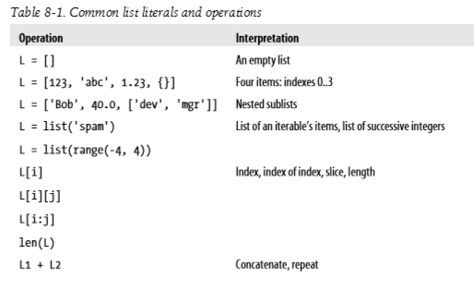

Slide 38
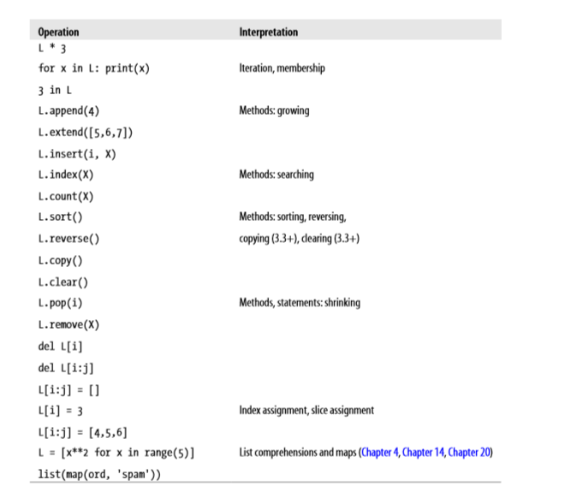

Slide 39
Exercise 1
Given a positions of coins of player1 and player2 in a 3X3 Tic Tac Toc board, write a program to determine if the board position is a solution and if so identify the winner of the game. In a Tic Tac Toc problem, if the coins in a row or column or along a diagonal is of the same player then he has won the game. Assume that player1 uses ‘1’ as his coin and player2 uses '2' as his coin. '0' in the board represent empty cell.

Slide 40
Exercise 2
In a supermarket there are two sections S1 and S2. The sales details of item₁ to item_{n} of section1 and item₁ to item_{p} of section2 are maintained in a sorted order. Write a program to merge the elements of the two sorted lists to form the consolidated list.

Slide 41
Exercise 3
Watson gives Sherlock an list of N numbers. Then he asks him to determine if there exists an element in the list such that the sum of the elements on its left is equal to the sum of the elements on its right. If there are no elements to the left/right, then the sum is considered to be zero.

Slide 42
Exercise 4
Sunny and Johnny together have M dollars they want to spend on ice cream. The parlor offers N flavors, and they want to choose two flavors so that they end up spending the whole amount.
You are given the cost of these flavors. The cost of the ith flavor is denoted by ci. You have to display the indices of the two flavors whose sum is M.

Slide 43
Exercise 5
Given a list of integer values, find the fraction of count of positive numbers, negative numbers and zeroes to the total numbers. Print the value of the fractions correct to 3 decimal places.

Slide 44
Exercise 6
Given N integers, count the number of pairs of integers whose difference is K.

